Slide 1

TVQA: Localized, Compositional Video Question Answering
tvqa.cs.unc.edu
Jie Lei, Licheng Yu, Mohit Bansal, Tamara L. Berg
EMNLP 2018, Brussels, Belgium
Notes:
Hello everyone, I am Jie.
Today I am going to present our paper, TVQA. My collaborators are Licheng, Mohit and Tamara.
We are from UNC Chapel Hill.

Slide 2
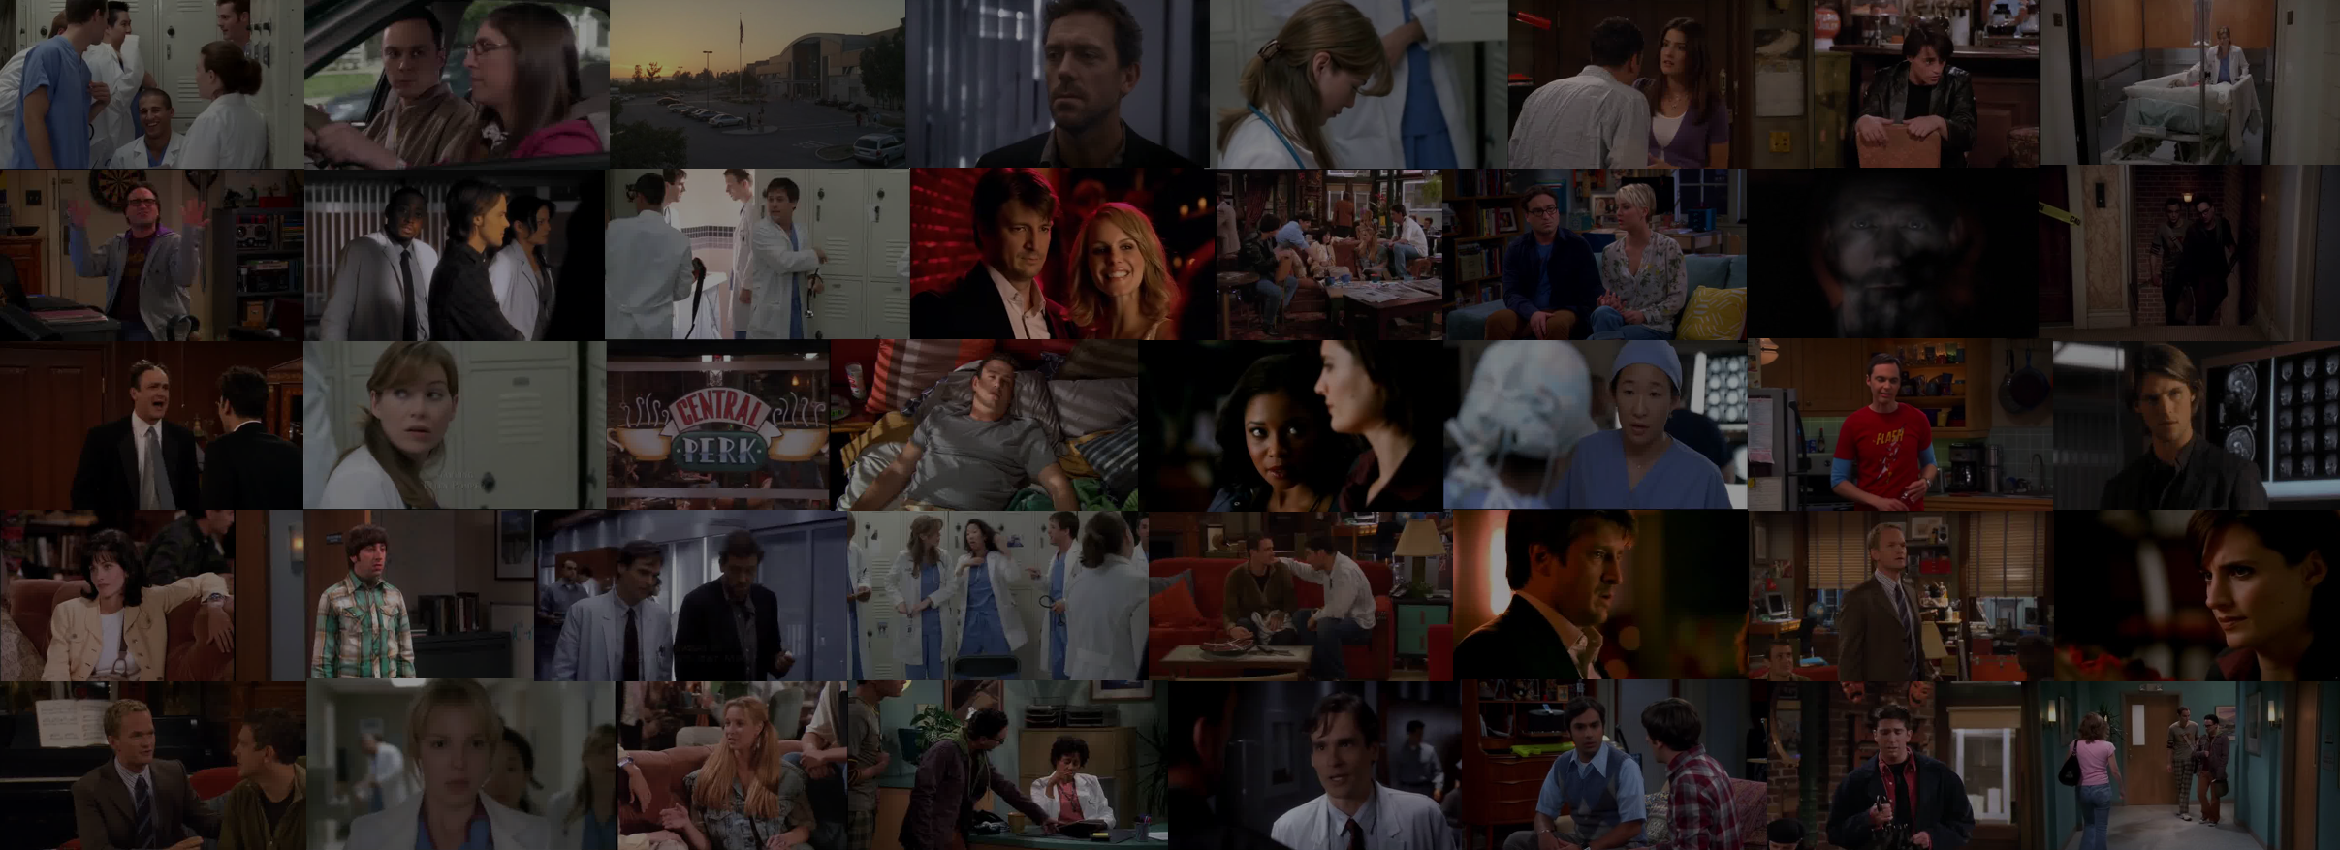
TVQA DATASET A Localized, Compositional Video Question Answering Dataset
tvqa.cs.unc.edu
Notes:
Now we introduce our TVQA dataset,
the first large-scale, localized, compositional video question answering dataset. It is available at our project page.
There are 4 advantages of our dataset, the first is …

Slide 3

TVQA DATASET A Localized, Compositional Video Question Answering Dataset
tvqa.cs.unc.edu
Large-Scale
Notes:
First, it’s large-scale, with more than 150 thousands of QA pairs

Slide 4

TVQA DATASET A Localized, Compositional Video Question Answering Dataset
tvqa.cs.unc.edu
Large-Scale
Compositional
Notes:
The TVQA questions are designed to be compositional,
requiring both visual and textual cues.

Slide 5

TVQA DATASET A Localized, Compositional Video Question Answering Dataset
tvqa.cs.unc.edu
Large-Scale
Compositional
Localized
Notes:
Third , TVQA questions are temporarily localized with timestamp annotation.

Slide 6

TVQA DATASET A Localized, Compositional Video Question Answering Dataset
tvqa.cs.unc.edu
Large-Scale
Compositional
Localized
Fun!
Notes:
The last, it’s fun!
TVQA videos are made from popular TV shows, such as The Big Bang Theory and Friends, which come with rich social interactions.

Slide 7
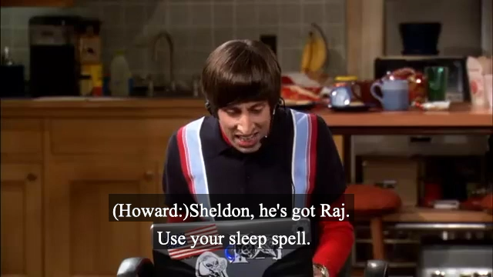
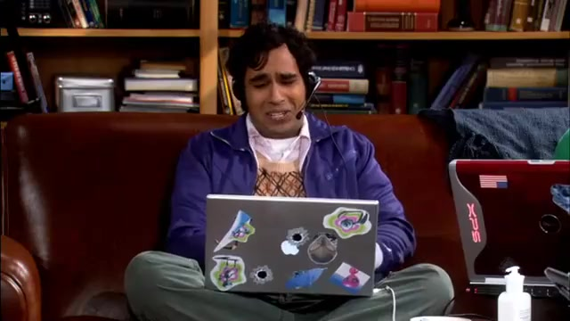
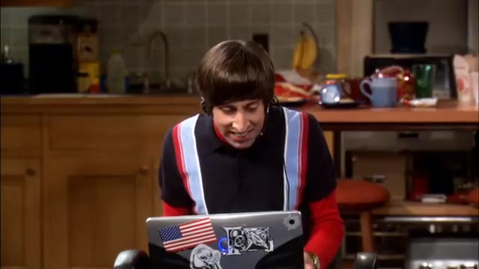
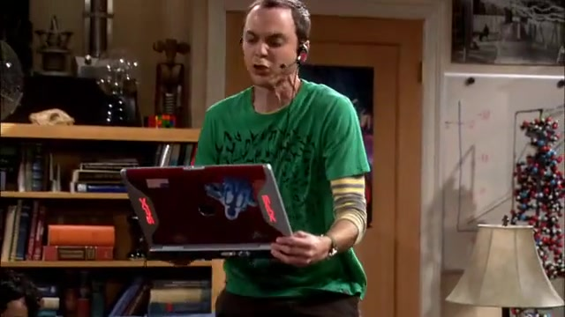
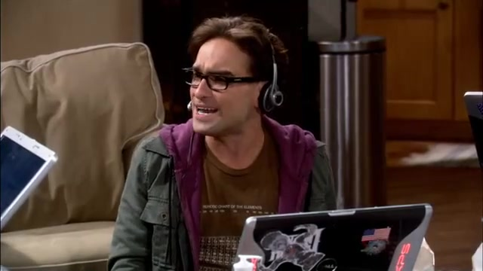
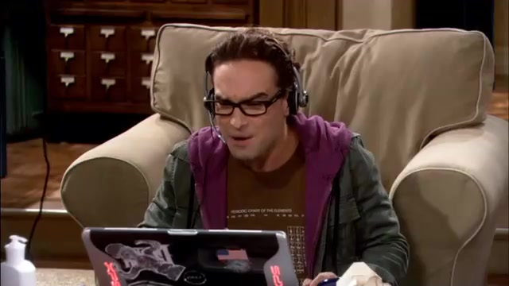
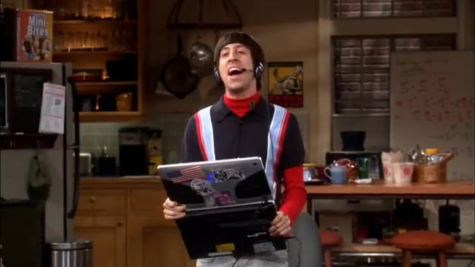
TVQA Dataset - Example
tvqa.cs.unc.edu
UNC-CS
What is Sheldon holding when
he is talking to Howard about the sword?
1) A comic book
2) A computer
3) A sword
4) A toy train
5) A drink
|
|
2s
10s
Notes:
Here is an example from our dataset, we show a localized 8 seconds-long clip,
its associated subtitle, along with a question and 5 candidate answers.

Slide 8
TVQA Dataset - Example
tvqa.cs.unc.edu
UNC-CS
What is Sheldon holding when
he is talking to Howard about the sword?
1) A comic book
2) A computer
3) A sword
4) A toy train
5) A drink
|
|
2s
10s
Notes:
Here is an example from our dataset, we show a localized 8 seconds-long clip,
its associated subtitle, along with a question and 5 candidate answers.

Slide 9
tvqa.cs.unc.edu
UNC-CS
TVQA Dataset - Collection
|
|
0s
62s
Notes:
To collect such questions, we show a video with aligned subtitle sentence as a natural source for collecting multimodal questions.

Slide 10
tvqa.cs.unc.edu
UNC-CS
TVQA Dataset - Collection
Write a question:
[What/Why/...] ___ [when/before/after] ___
Question
+
Localization
|
|
0s
62s
Notes:
Next, we ask the workers to write a question using our compositional format.
The compositional format consists of two parts,
The question part

Slide 11
tvqa.cs.unc.edu
UNC-CS
TVQA Dataset - Collection
Write a question:
[What/Why/...] ___ [when/before/after] ___
Question
+
Localization
What is Sheldon holding
|
|
0s
62s
Notes:
The compositional format consists of two parts,
The question part “what is Sheldon holding”, the localization part is …

Slide 12
tvqa.cs.unc.edu
UNC-CS
TVQA Dataset - Collection
Write a question:
[What/Why/...] ___ [when/before/after] ___
Question
+
Localization
he is talking to Howard about the sword?
|
|
0s
62s
Notes:
and the localization part “he is talking to Howard about the sword”
this two parts

Slide 13
tvqa.cs.unc.edu
UNC-CS
TVQA Dataset - Collection
Write a question:
[What/Why/...] ___ [when/before/after] ___
Question
+
Localization
What is Sheldon holding when
he is talking to Howard about sword?
|
|
0s
62s
Notes:
are nicely joined together using one of one of the link words.
The link words

Slide 14
tvqa.cs.unc.edu
UNC-CS
TVQA Dataset - Collection
Write a question:
[What/Why/...] ___ [when/before/after] ___
Question
+
Localization
“What is Sheldon holding when
he is talking to Howard about the sword?”
|
|
0s
62s
Notes:
The link words themselves reflect the temporal order of these two parts.

Slide 15
tvqa.cs.unc.edu
TVQA Dataset Introduction
tvqa.cs.unc.edu
UNC-CS
TVQA Dataset - Collection
What is Sheldon holding when he is talking to Howard about the sword?
Write 1 correct answer:
A computer
|
|
0s
62s
Notes:
Later on, we ask them to write 1 correct answer and …

Slide 16
tvqa.cs.unc.edu
TVQA Dataset Introduction
tvqa.cs.unc.edu
UNC-CS
TVQA Dataset - Collection
What is Sheldon holding when he is talking to Howard about the sword?
Write 1 correct answer:
A computer
Write 4 wrong (but relevant) answers:
1) A comic book
2) A sword
3) A toy train
4) A drink
|
|
0s
62s
Notes:
4 wrong but relevant answers for this question. Which makes our negative answers tricky.

Slide 17
tvqa.cs.unc.edu
UNC-CS
TVQA Dataset - Collection
1) A comic book
2) A sword
3) A toy train
4) A drink
What is Sheldon holding when
he is talking to Howard about the sword?
A computer
Mark the START and END timestamps:
0s |
| 62s
Notes:
The last step is to mark the START and END timestamp for this question,
where they are required to localize all the information needed to answer this question.

Slide 18
tvqa.cs.unc.edu
UNC-CS
TVQA Dataset - Collection
1) A comic book
2) A sword
3) A toy train
4) A drink
What is Sheldon holding when
he is talking to Howard about the sword?
A computer
Mark the START and END timestamps:
2s |
| 10s
START
END
Notes:
The last step is to mark the START and END timestamp for this question,
where they are required to localize all the information needed to answer this question.

Slide 19
tvqa.cs.unc.edu
UNC-CS
TVQA Dataset - Example
What is Sheldon holding when
he is talking to Howard about the sword?
1) A comic book
2) A computer
3) A sword
4) A toy train
5) A drink
|
|
2s
10s
Notes:
After going through this collection process, we got one TVQA question.
To answer this question …

Slide 20
tvqa.cs.unc.edu
UNC-CS
TVQA Dataset - Example
What is Sheldon holding when
he is talking to Howard about the sword?
1) A comic book
2) A computer
3) A sword
4) A toy train
5) A drink
|
|
2s
10s
Notes:
To answer this question, it is helpful for the model to first localize the moment
‘when he is talking to Howard about sword’ from the subtitles, then answer …

Slide 21
tvqa.cs.unc.edu
UNC-CS
TVQA Dataset - Example
What is Sheldon holding when
he is talking to Howard about the sword?
1) A comic book
2) A computer
3) A sword
4) A toy train
5) A drink
|
|
2s
10s
Notes:
then answer the question from the video. So it’s …

Slide 22
tvqa.cs.unc.edu
UNC-CS
TVQA Dataset - Example
What is Sheldon holding when
he is talking to Howard about the sword?
1) A comic book
2) A computer
3) A sword
4) A toy train
5) A drink
|
|
2s
10s
Notes:
So it’s textual localization + visual question answering

Slide 23
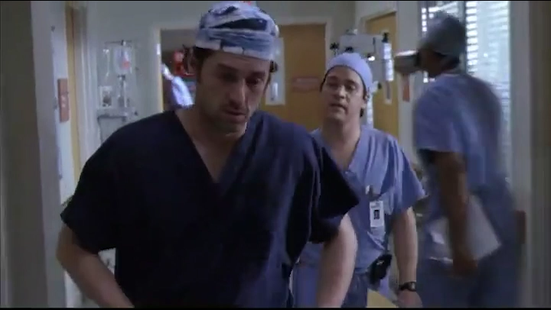
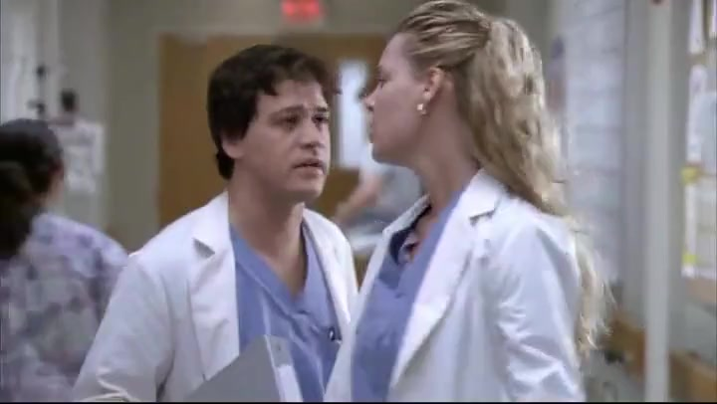
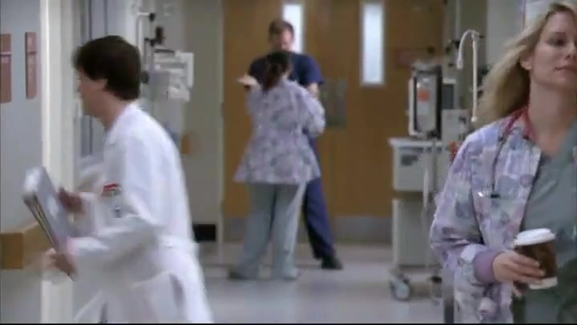
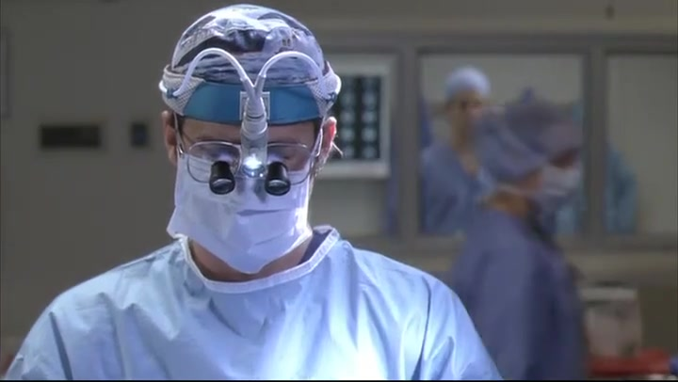
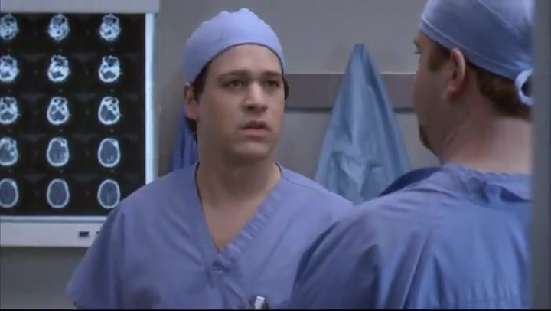
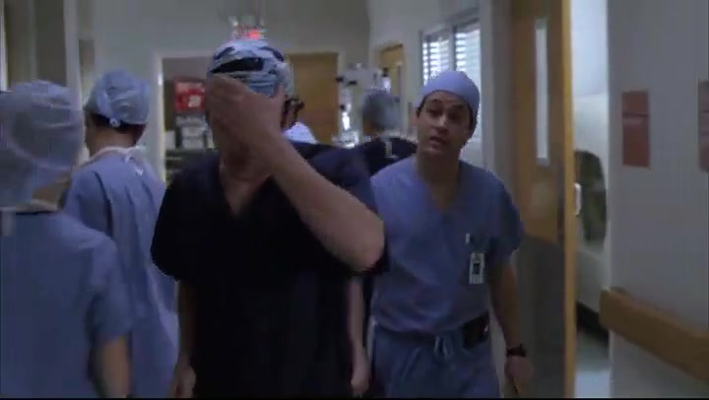
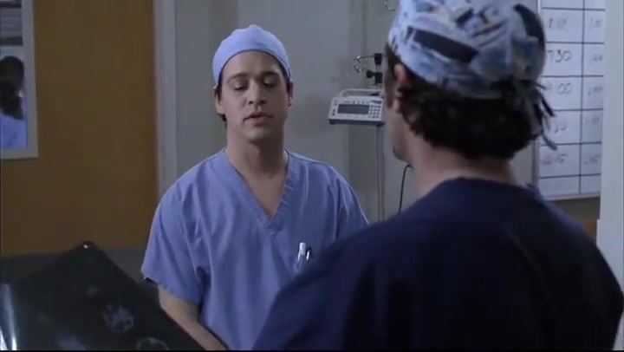
tvqa.cs.unc.edu
UNC-CS
TVQA Dataset - Example
tvqa.cs.unc.edu
TVQA Dataset Introduction
What does Derek tell George when George hands Derek the brain scans of Jamie Hayes?
1) Derek needs new brain scans
2) Jamie Hayes needs to leave
3) George shouldn't bother doctors
4) The brain scans look cool
5) George needs to get coffee
73s |
| 91s
Notes:
Here is another example.
The question is “What does Derek tell George when George hands Derek the brain scans of Jamie Hayes?”
Now let’s watch this video….

Slide 24
tvqa.cs.unc.edu
UNC-CS
TVQA Dataset - Example
tvqa.cs.unc.edu
TVQA Dataset Introduction
What does Derek tell George when George hands Derek the brain scans of Jamie Hayes?
1) Derek needs new brain scans
2) Jamie Hayes needs to leave
3) George shouldn't bother doctors
4) The brain scans look cool
5) George needs to get coffee
73s |
| 91s
Notes:
… To answer this question, again, it is helpful for the model to first visually localize the moment “George hands Derek the brain scans of Jamie Hayes”
… then answer the question “what does Derek tell George” from the subtitle.

Slide 25
tvqa.cs.unc.edu
UNC-CS
TVQA Dataset - Example
tvqa.cs.unc.edu
TVQA Dataset Introduction
What does Derek tell George when George hands Derek the brain scans of Jamie Hayes?
1) Derek needs new brain scans
2) Jamie Hayes needs to leave
3) George shouldn't bother doctors
4) The brain scans look cool
5) George needs to get coffee
73s |
| 91s
Notes:
Then answer the question “what doers Derek tell George” from the subtitle

Slide 26
tvqa.cs.unc.edu
UNC-CS
TVQA Dataset - Example
tvqa.cs.unc.edu
TVQA Dataset Introduction
What does Derek tell George when George hands Derek the brain scans of Jamie Hayes?
1) Derek needs new brain scans
2) Jamie Hayes needs to leave
3) George shouldn't bother doctors
4) The brain scans look cool
5) George needs to get coffee
73s |
| 91s
Notes:
So in conclusion, it’s visual localization + textual question answering.

Slide 27
tvqa.cs.unc.edu
UNC-CS
TVQA Dataset - Statistics
6 TV shows, 3 genres:
Sitcom: The Big Bang Theory, Friends, How I Met Your Mother
Medical: Grey’s anatomy, House M.D.
Crime: Castle
Data Statistics for each TV show. BBT = The Big Bang Theory, HIMYM = How I Met You Mother, Grey = Grey’s Anatomy, House = House M.D., Epi = Episode, Sea. = Season
Notes:
Following this strategy, we collected over 150K QA pairs from 6 TV shows, across 3 genres.
We have 3 tv shows from sitcom, …
2 from medical, …
And 1 from crime …

Slide 28
tvqa.cs.unc.edu
UNC-CS
TVQA Dataset - Statistics
6 TV shows, 3 genres:
Sitcom: The Big Bang Theory, Friends, How I Met Your Mother
Medical: Grey’s anatomy, House M.D.
Crime: Castle
Data Statistics for each TV show. BBT = The Big Bang Theory, HIMYM = How I Met You Mother, Grey = Grey’s Anatomy, House = House M.D., Epi = Episode, Sea. = Season
Notes:
Following this strategy, we collected over 150K QA pairs from 6 TV shows, across 3 genres.
We have 3 tv shows from sitcom, …
2 from medical, …
And 1 from crime …

Slide 29
tvqa.cs.unc.edu
UNC-CS
TVQA Dataset - Statistics
6 TV shows, 3 genres:
Sitcom: The Big Bang Theory, Friends, How I Met Your Mother
Medical: Grey’s anatomy, House M.D.
Crime: Castle
Data Statistics for each TV show. BBT = The Big Bang Theory, HIMYM = How I Met You Mother, Grey = Grey’s Anatomy, House = House M.D., Epi = Episode, Sea. = Season
Notes:
Following this strategy, we collected over 150K QA pairs from 6 TV shows, across 3 genres.
We have 3 tv shows from sitcom, …
2 from medical, …
And 1 from crime …

Slide 30
tvqa.cs.unc.edu
UNC-CS
TVQA Dataset - Statistics
6 TV shows, 3 genres:
Sitcom: The Big Bang Theory, Friends, How I Met Your Mother
Medical: Grey’s anatomy, House M.D.
Crime: Castle
Data Statistics for each TV show. BBT = The Big Bang Theory, HIMYM = How I Met You Mother, Grey = Grey’s Anatomy, House = House M.D., Epi = Episode, Sea. = Season
Notes:
Following this strategy, we collected over 150K QA pairs from 6 TV shows, across 3 genres.
We have 3 tv shows from sitcom, …
2 from medical, …
And 1 from crime …

Slide 31
tvqa.cs.unc.edu
UNC-CS
TVQA Dataset - Statistics
Different show comes with different words
Top unique nouns in question and correct answer
Notes:
We noticed that different shows come with different set of top unique nouns.
For example, sitcom shows contain mostly daily objects/scenes/actions,
Such as game, shop, and beer. While

Slide 32
tvqa.cs.unc.edu
UNC-CS
TVQA Dataset - Statistics
Different show comes with different words
Top unique nouns in question and correct answer
Notes:
We noticed that different shows feature different set of top unique nouns.
For example, sitcom shows contain mostly daily objects/scenes/actions,
Such as game, shop, and beer. While

Slide 33
tvqa.cs.unc.edu
UNC-CS
TVQA Dataset - Statistics
Different show comes with different words
Top unique nouns in question and correct answer
Notes:
While medical shows contain more medical terms, such as nurse and hospital.

Slide 34
tvqa.cs.unc.edu
UNC-CS
TVQA Dataset - Statistics
Question types:
Abstract (what): text summarization
Action (what): action recognition
Reasoning (why): reasoning
…
Distribution of question types based on answer types.
Notes:
TVQA questions are distributed in different question types,
we have abstract question, action questions, reasoning questions and so on.
By measuring the model’s performance on these different question types,
We can, to some extent, evaluate the model’s comprehension ability in different aspects,
such as text summarization and action recognition.

Slide 35
tvqa.cs.unc.edu
UNC-CS
TVQA Dataset - Statistics
Dataset Comparison
Comparison of TVQA to various existing video QA datasets. OE = open-ended, MC = multiple-choices. Q. Src. = Question Sources, it indicates where the questions are raised from.
Notes:
This page shows a comparison of TVQA to various existing videoQA datasets.
In the last three columns, ...

Slide 36
tvqa.cs.unc.edu
UNC-CS
TVQA Dataset - Statistics
Dataset Comparison
Comparison of TVQA to various existing video QA datasets. OE = open-ended, MC = multiple-choices. Q. Src. = Question Sources, it indicates where the questions are raised from.
Notes:
In the last three columns, Q. Src. Is short for question source, indicates where the questions come from.
It has two options, text and video. If only text is checked,
it means the questions in this dataset are collected based on text information.
For example …

Slide 37
tvqa.cs.unc.edu
UNC-CS
TVQA Dataset - Statistics
Dataset Comparison
Comparison of TVQA to various existing video QA datasets. OE = open-ended, MC = multiple-choices. Q. Src. = Question Sources, it indicates where the questions are raised from.
Notes:
For example, let’s look at the MovieQA dataset,
the questions in this dataset are collected by people reading plot summaries of the movies.
So it’s question source only contains text and without video.
In contrast, TVQA questions are collected by people watching videos with subtitles,
so it’s question source contains both text and video.
We believe our strategy is better at collecting multimodal questions.
The last …

Slide 38
tvqa.cs.unc.edu
UNC-CS
TVQA Dataset - Statistics
Dataset Comparison
Comparison of TVQA to various existing video QA datasets. OE = open-ended, MC = multiple-choices. Q. Src. = Question Sources, it indicates where the questions are raised from.
Notes:
The last column ‘timestamp annotation’ indicates whether the dataset comes with temporal annotations.

Slide 39
tvqa.cs.unc.edu
UNC-CS
TVQA Dataset - Statistics
Dataset Comparison
Comparison of TVQA to various existing video QA datasets. OE = open-ended, MC = multiple-choices. Q. Src. = Question Sources, it indicates where the questions are raised from.
Notes:
Among the 5 video QA datasets,
TVQA is the only dataset that combines all the 3 factors, text source, video source and timestamp annotation.

Slide 40
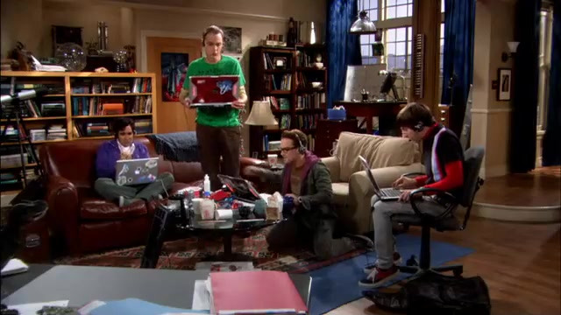
TVQA Tasks
tvqa.cs.unc.edu
UNC-CS
Task 1: Question answering without timestamp annotation
0s |
| 62s
Notes:
We provide two tasks for the dataset,
the first is question answering without timestamp annotation, where the model has to look at the full video to seek the answer.
The second is question answering with …

Slide 41
TVQA Tasks
tvqa.cs.unc.edu
UNC-CS
Task 1: Question answering without timestamp annotation
0s |
| 62s
Task 2: Question answering with timestamp annotation
2s |
| 10s
START
END
Notes:
The second is question answering with timestamp annotation,
in this task we provide additional timestamp annotation for the model

Slide 42
Model - Input
tvqa.cs.unc.edu
UNC-CS
What is Sheldon holding when
he is talking to Howard about sword?
1) A comic book
2) A computer
3) A sword
4) A toy train
5) A drink
A Question with
5 candidate answers
Notes:
Now we show the inputs to our model.
Firstly, a question with 5 candidate answers.
And …

Slide 43
Model - Input
tvqa.cs.unc.edu
UNC-CS
(Howard:)Sheldon, he‘s got Raj. Use your sleep spell. Sheldon. Sheldon.
(Sheldon:)I've got the Sword of Azeroth.
…
Subtitle sentences
Notes:
And then subtitles.

Slide 44
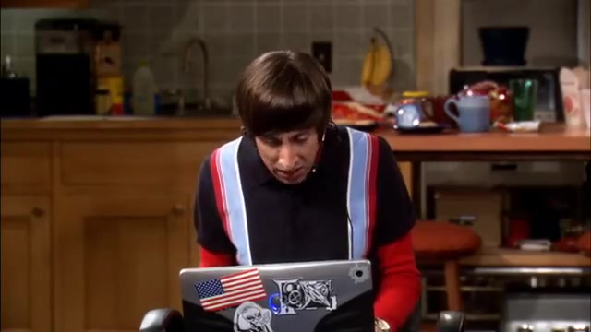
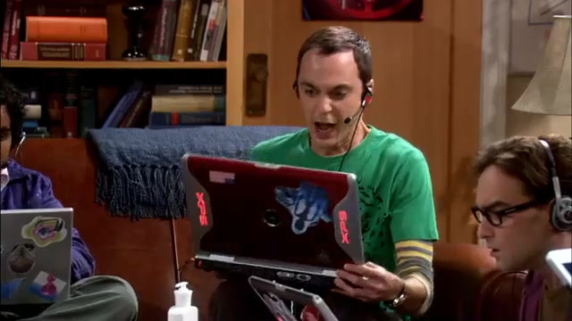
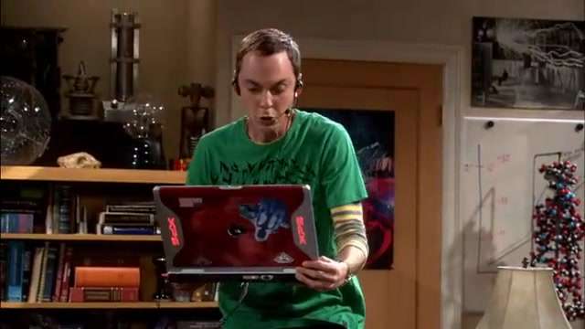

Model - Input
tvqa.cs.unc.edu
UNC-CS
Video frames
Notes:
For visual inputs, we use video frames. We extracted 3 different features …

Slide 45
Model - Input
tvqa.cs.unc.edu
UNC-CS
ResNet101
ImageNet feature (img)
He, Kaiming, et al. Deep residual learning for image recognition. CVPR 2016
Russakovsky, Olga, et al. Imagenet large scale visual recognition challenge. IJCV 2015
Notes:
For visual inputs, we extracted the following features from video frames:
ImageNet feature
Regional feature ..
Visual concept feature
We show example detections from Faster R-CNN, the ROI

Slide 46
Model - Input
tvqa.cs.unc.edu
UNC-CS
Object Detector
Faster R-CNN trained on Visual Genome
Regional Visual feature (reg)
Ren, Shaoqing, et al. Faster R-CNN: Towards real-time object detection with region proposal networks. NIPS 2015
Anderson, Peter, et al. Bottom-up and top-down attention for image captioning and VQA. CVPR 2018
Krishna, Ranjay, et al. Visual Genome: Connecting language and vision using crowdsourced dense image annotations. IJCV 2017
Notes:
The second is regional visual feature, which are object encodings from object detector.
In this work, we used a faster R-CNN trained on Visual Genome.
The third …

Slide 47
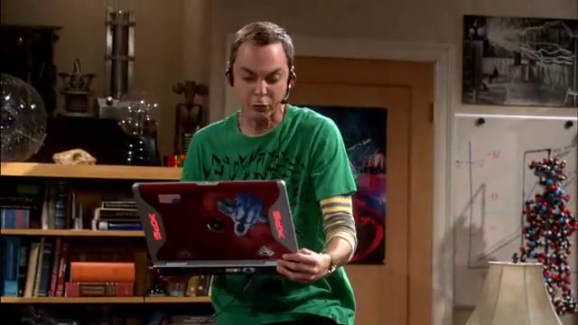
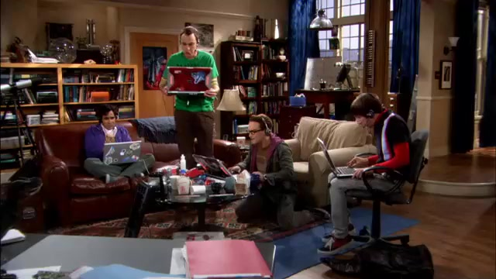
Model - Input
tvqa.cs.unc.edu
UNC-CS
Object Detector
floor, table, room, green shirt, blue curtain, chair, laptop, shelf, red chair,
Faster R-CNN trained on Visual Genome
Visual concepts feature (cpt)
Ren, Shaoqing, et al. Faster R-CNN: Towards real-time object detection with region proposal networks. NIPS 2015
Anderson, Peter, et al. Bottom-up and top-down attention for image captioning and VQA. CVPR 2018
Krishna, Ranjay, et al. Visual Genome: Connecting language and vision using crowdsourced dense image annotations. IJCV 2017
Notes:
The third is visual concepts feature, which are object labels and attributes from object detector.

Slide 48
Model - Input
tvqa.cs.unc.edu
UNC-CS
Faster R-CNN detection example
The regional visual feature (image embeddings inside the bounding boxes) and visual concepts feature (shown in the caption) can be used to answer the question:
‘What is Sheldon holding when everyone is at the door?’ (basket).
Ren, Shaoqing, et al. Faster R-CNN: Towards real-time object detection with region proposal networks. NIPS 2015
Anderson, Peter, et al. Bottom-up and top-down attention for image captioning and VQA. CVPR 2018
Krishna, Ranjay, et al. Visual Genome: Connecting language and vision using crowdsourced dense image annotations. IJCV 2017
Notes:
Here is a detection example from faster-R-CNN. [read the slides]

Slide 49
Model - Overview
tvqa.cs.unc.edu
UNC-CS
Multiple streams, each stream deals with different contextual input
Notes:
To answer TVQA questions, we propose the following neural model.
This model has multiple streams, each stream deals with different contextual input.
For example, the upper stream takes care of videos while the bottom stream takes care of subtitle
This architecture is inspired by the popular two-stream action recognition models.

Slide 50
Model - Overview
tvqa.cs.unc.edu
UNC-CS
Multiple streams, each stream deals with different contextual input
Upper stream -- Video
Notes:
For example, the upper stream takes care of videos ….
while the bottom stream takes care of subtitle

Slide 51
Model - Overview
tvqa.cs.unc.edu
UNC-CS
Multiple streams, each stream deals with different contextual input
Bottom stream -- Subtitle
Notes:
… while the bottom stream takes care of subtitle.

Slide 52
tvqa.cs.unc.edu
UNC-CS
Model - Details
Output from subtitle stream
Take the regional visual feature (reg) stream as an example:
Notes:
Now, we explain the model in detail. Take the regional visual feature stream as an example.
The textual sentences,

Slide 53
tvqa.cs.unc.edu
UNC-CS
Model - Details
Output from subtitle stream
Take the regional visual feature (reg) stream as an example:
Question and Answers
Notes:
The textual sentences, including question and answer sentences,
are encoded using pretrained word embedding and a LSTM encoder.
The video frames …

Slide 54
tvqa.cs.unc.edu
UNC-CS
Model - Details
Output from subtitle stream
Take the regional visual feature (reg) stream as an example:
Question and Answers
Video frames
Notes:
The video frames, are firstly fed into R-CNN to extract object level features,
and then encoded using a non-linear layer along with a shared LSTM encoder.
The encoded context-query pairs,

Slide 55
tvqa.cs.unc.edu
UNC-CS
Model - Details
context-to-query attention
Output from subtitle stream
Take the regional visual feature (reg) stream as an example:
Question and Answers
Video frames
Context-query pair (video-question, video-answer)
Notes:
The encoded context-query pairs, such as video-question pair,
are then jointly fed into the context matching module, which is essentially a context-to-query attention layer.
After the context matching, we obtain the context-aware-query representations.
These representations are then fused together.

Slide 56
tvqa.cs.unc.edu
UNC-CS
Model - Details
Output from subtitle stream
Take the regional visual feature (reg) stream as an example:
Fused representation answer probabilities
Notes:
The fused representation are then fed into another LSTM encoder,
followed by a maxpooling layer, along with a softmax classifier to get the final answer probabilities.
When multiple streams are used …

Slide 57
tvqa.cs.unc.edu
UNC-CS
Model - Details
Output from subtitle stream
Take the regional visual feature (reg) stream as an example:
Fused representation answer probabilities
When multiple streams are used, their unnormalized answer probabilities are added together
Notes:
When multiple streams are used, their unnormalized answer probabilities are added together.
…

Slide 58
Experiments – Data Splits
tvqa.cs.unc.edu
UNC-CS
80% training set (122K QAs)
10% validation set (15K QAs)
10% test set (15K QAs)
Notes:
For experiment, we split the dataset into 80% training, 10% validation and 10% testing.
Questions from the same clip are put into the same split,
this ensures that the model will never see clips from the test set during training.

Slide 59
Experiments - Baselines
tvqa.cs.unc.edu
UNC-CS
Longest answer
Nearest neighbor search (NNS)
2-step retrieval
Test question
Retrieve
Closest training question
Closest test answer
Retrieve
Closest training question’s correct answer
Embeddings: GloVe, SkipThought and TFIDF
Similarity metric: cosine similarity
Pennington et al. 2014, Kiros et al. 2015
Notes:
We provide multiple baseline methods for the task.,
including Longest answer, where the longest answer will be chose.
And then nearest neighbor search, where we choose the closet answer to the given question or given subtitle as the correct answer.
And finally a 2-step retrieval based approach.
In this approach, we first retrieve the most similar question from the training set,
then find the closest candidate answer to the retrieved training question’s correct answer.
For the last two approaches, we use GloVe, SkipThought and TFIDF vectors as features, and use cosine similarity as our metric.

Slide 60
Experiments - Results
tvqa.cs.unc.edu
UNC-CS
Accuracy for different methods on TVQA test set. Q = Question, S = Subtitle, V = Video, img = ImageNet features, reg = regional visual features, cpt = visual concept features, ts = timestamp annotation.
without subtitle
Subtitle is important!
with subtitle
Notes:
Here are the results.
For the baselines, methods with subtitle are better than the ones without subtitle (row 2-7).
This comparison suggests subtitle are important for answering the questions.
This page shows the …

Slide 61
Experiments - Results
tvqa.cs.unc.edu
UNC-CS
Accuracy for different methods on TVQA test set. Q = Question, S = Subtitle, V = Video, img = ImageNet features, reg = regional visual features, cpt = visual concept features, ts = timestamp annotation.
Question only
Both visual and textual information are important!
+ Video
+ Subtitle
+ Video, Subtitle
Notes:
This page shows the comparison of variants of our proposed model.
Compared to the question only model, when adding videos or adding subtitles, the model’s performance improves in most cases.
When adding both video and subtitle, we get the best results. This indicates that both visual and textual information are important!

Slide 62
Experiments - Results
tvqa.cs.unc.edu
UNC-CS
Accuracy for different methods on TVQA test set. Q = Question, S = Subtitle, V = Video, img = ImageNet features, reg = regional visual features, cpt = visual concept features, ts = timestamp annotation.
Timestamp information is helpful
Notes:
This page shows that models with timestamps work better than those without.

Slide 63
Experiments – Quality of Wrong Answers
tvqa.cs.unc.edu
UNC-CS
Rand: randomly sampled negatives
Human: human written negatives
Human written negative answers are challenging!
Accuracy on TVQA validation set with negative answers collected using different strategies. Negative Answer Source (N.A. Src.) indicates the collection method of the negative answers.
Notes:
This page shows a comparison between models on
randomly sampled negative answers and human written negative answers.
The results are not surprising, the model performs much better on randomly sampled negative answers.
Which indicates our human written negatives are challenging!

Slide 64
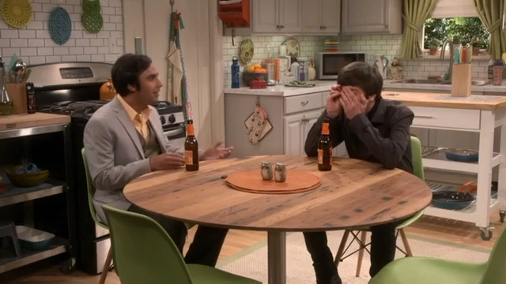
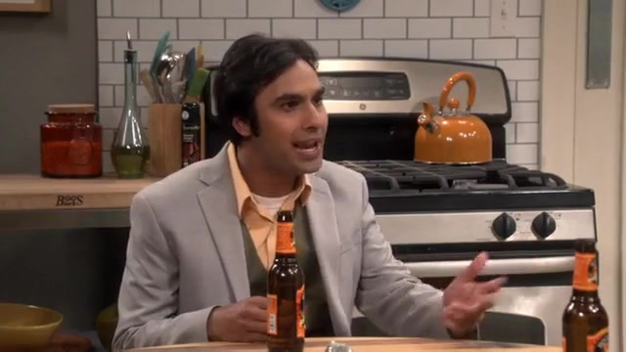
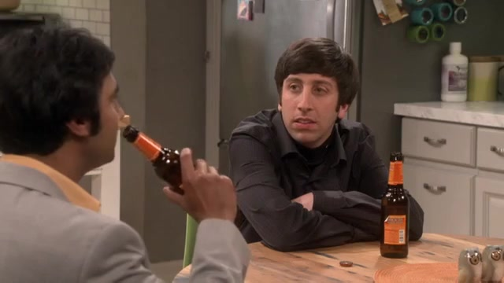
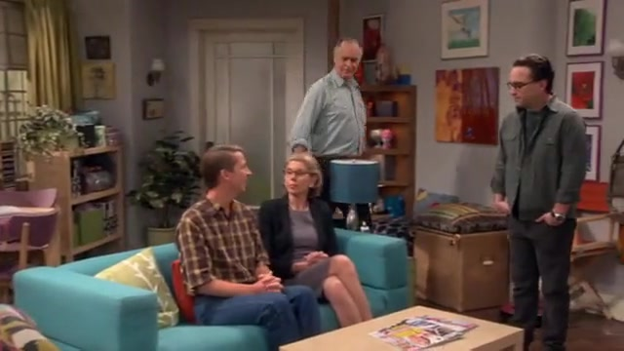
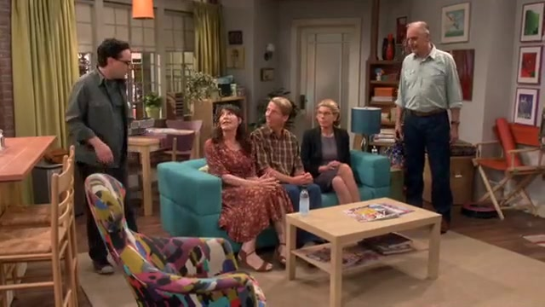
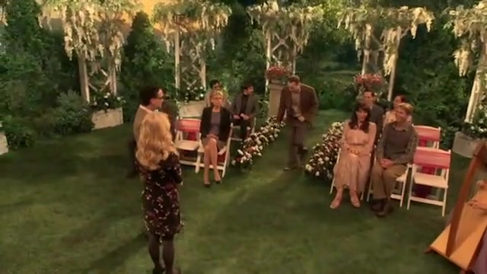
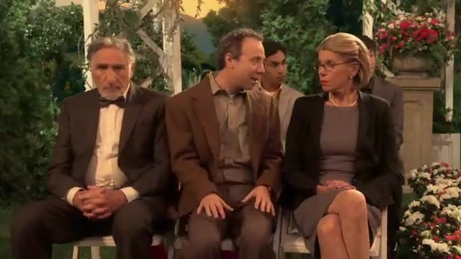
Experiments - Results
tvqa.cs.unc.edu
UNC-CS
What Raj and Howard are drinking when sat at the table?
1) Milk
2) Beer
3) Juice
4) Vodka
5) Carrot juice
The correct answer is in green,
model prediction is underlined
|
|
0s
10s
Notes:
This is a correct prediction of our model.

Slide 65
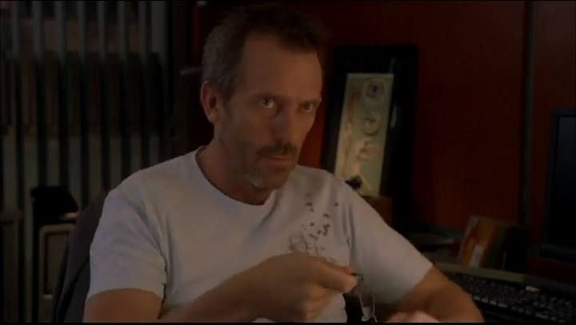
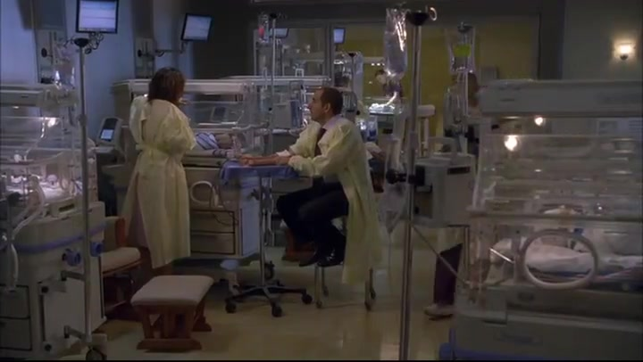
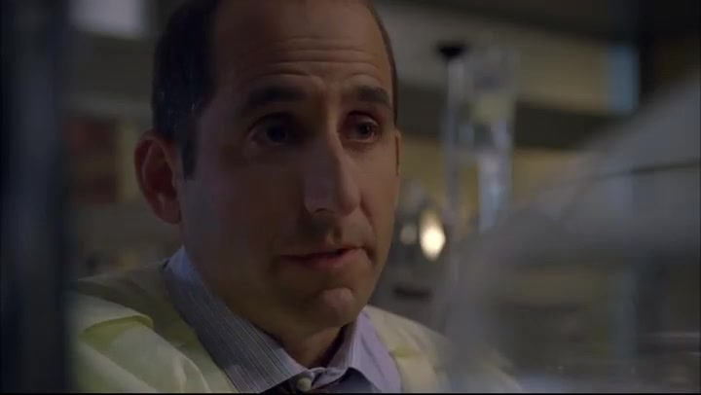
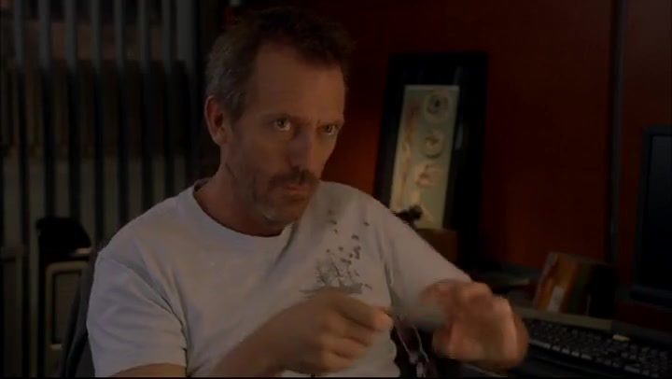
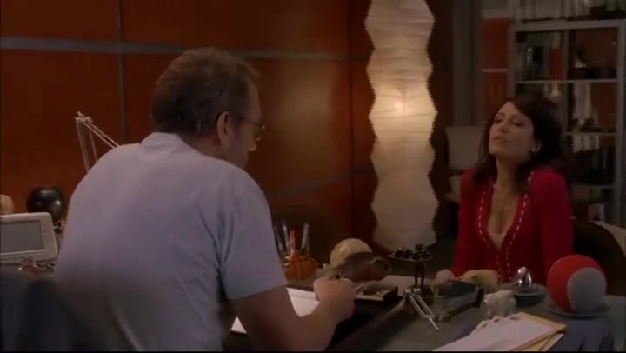
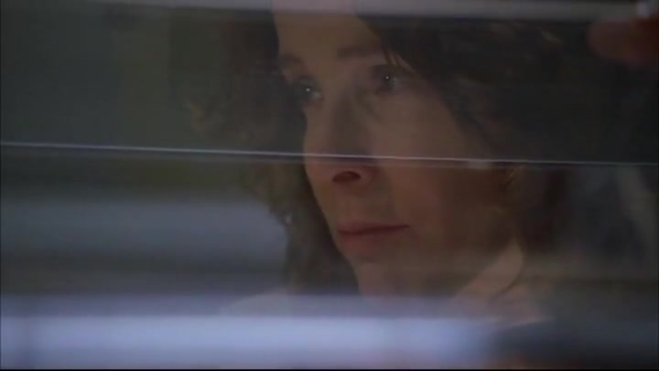
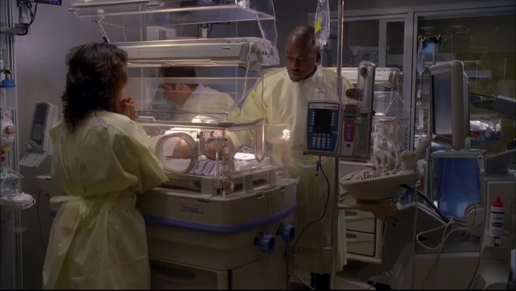
Experiments - Results
tvqa.cs.unc.edu
UNC-CS
Where is House when Cuddy comes to talk to him about the irradiated badge?
0) Wilson 's room
1) The cafeteria
2) His office
3) The radiology department
4) Cuddy 's office
The correct answer is in green,
model prediction is underlined
|
|
32s
42s
Notes:
This is a wrong prediction example. Let’s watch the video to look for some possible reasons.
The model is possibly distracted by the word ‘radiology’ in the subtitle and thus choosing the answer the radiology department.

Slide 66
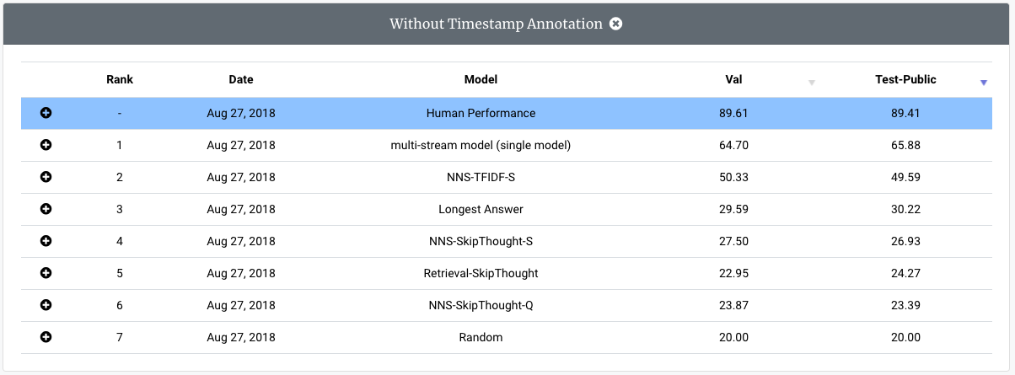
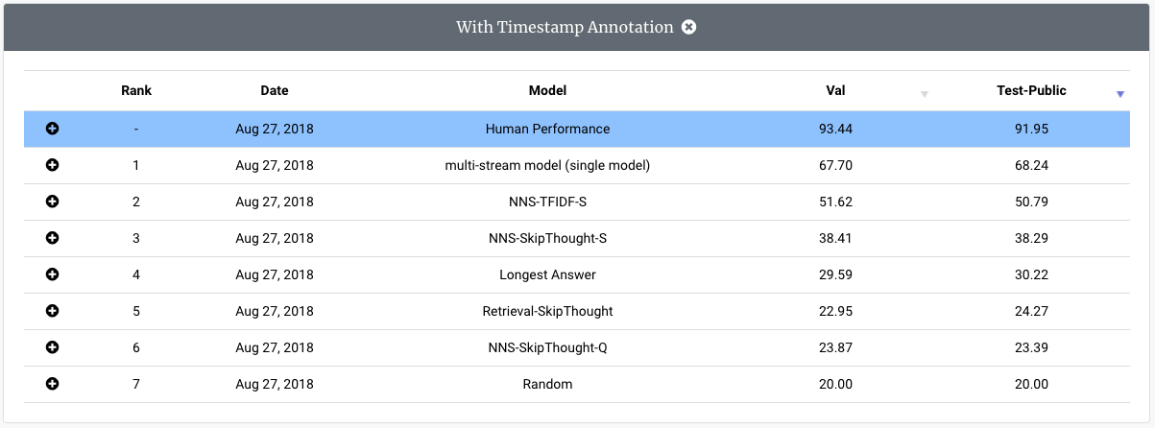
tvqa.cs.unc.edu
UNC-CS
Leaderboard
TVQA leaderboard at:
tvqa.cs.unc.edu/leaderboard
Workshop coming soon!
Notes:
All the experiments are in our leaderboard, currently we only have results from our own paper, we welcome everyone to join us.

Slide 67

tvqa.cs.unc.edu
UNC-CS
Code Release
TVQA benchmark models and starter code
are released at:
https://github.com/jayleicn/TVQA
Notes:
All the benchmark models and starter code are released at my github repo.

Slide 68
Thank you for your attention!
UNC-CS
tvqa.cs.unc.edu
TVQA DATASET A Localized, Compositional Video Question Answering Dataset
tvqa.cs.unc.edu
Acknowledgment: NSF, Google, Bloomberg, ARO-YIP
Notes:
Thanks!

